Slide 1

GROUP 8:
COMPUTER STORE
Member:
Ngô Hoàn Tâm Huy CE140548 Ngô Nguyễn Hồng Hải Long CE140007 Trần Ngọc Mẫn Huy CE140289 Trần Hoàng Quí CE140632
Mentor:
Võ Hồng Khanh

Slide 2
TABLE OF CONTENT
01
Toppic
02
Tool
03
Actor
04
Usecase
05
Sitemap
06
Demo

Slide 3
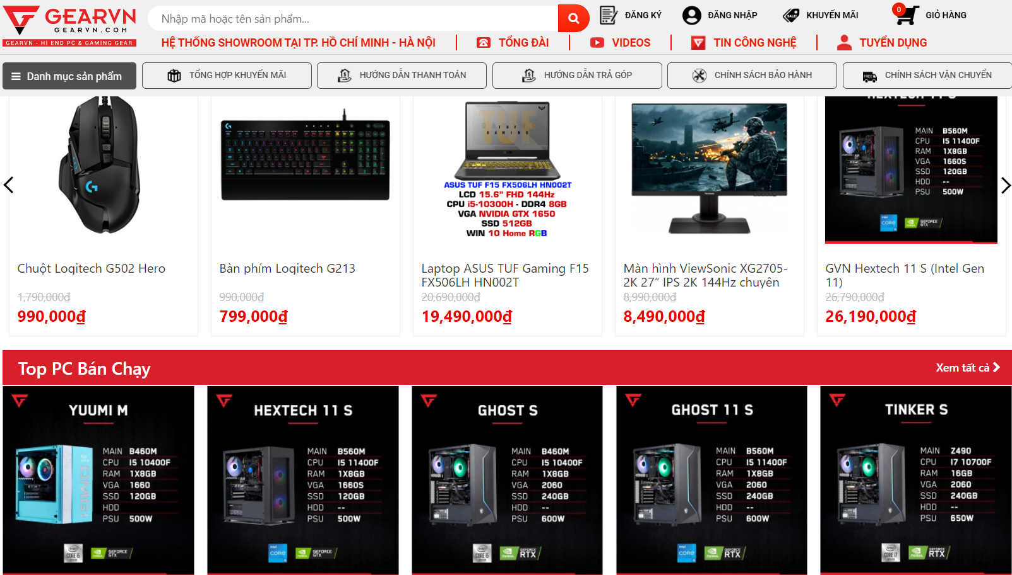
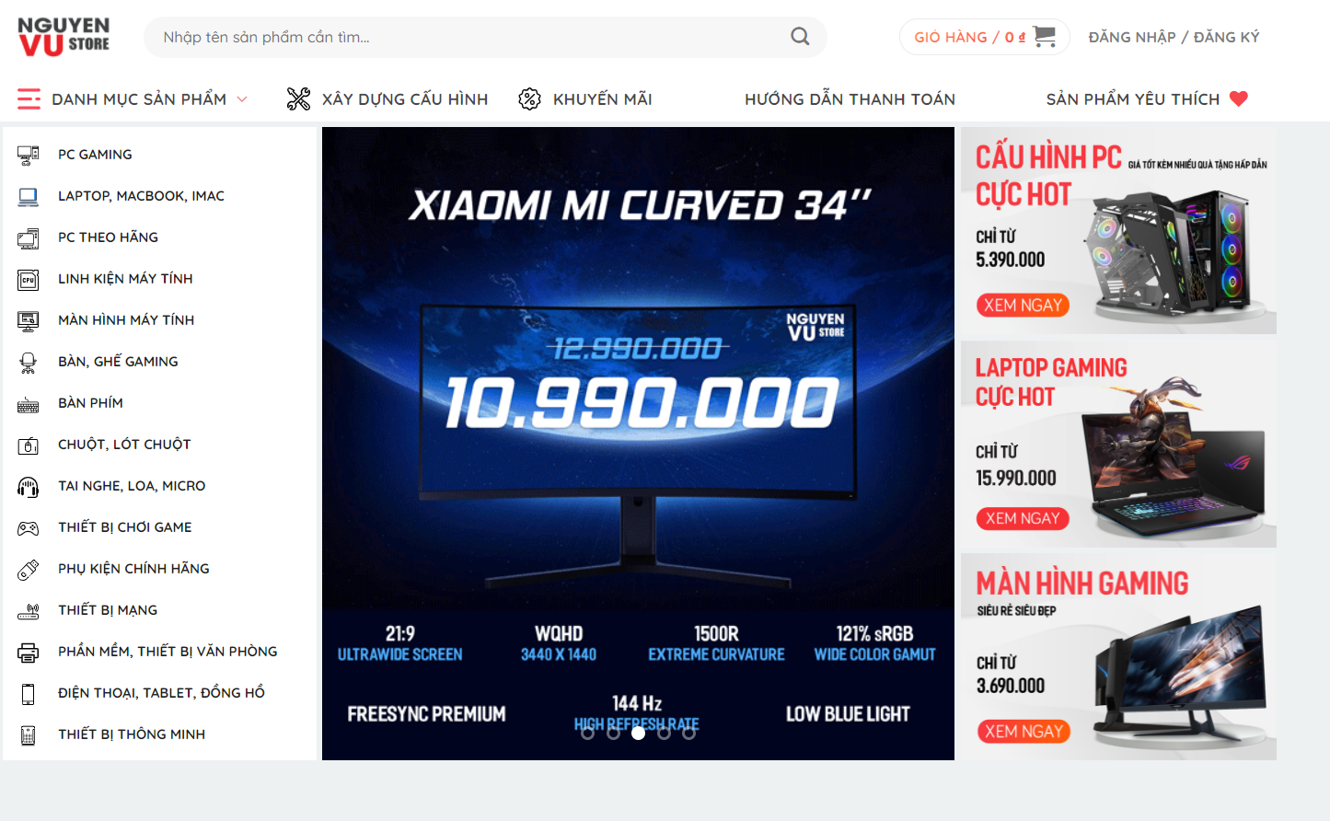
Computer store website
1. TOPIC

Slide 4

2. TOOL
WEBFLOW
PROS
Provide many utilities API
Friendly interface easy to use
Good customer support
Has free edition
CONS
Limit the number of pages to create only 2 pages
Can't work with other members
Many functions you want to use have to pay extra

Slide 5

3. ACTOR
CUSTOMER
ADMIN
CUSTOMER
A
c
EMPOYEE
GUESS
E
G

Slide 6
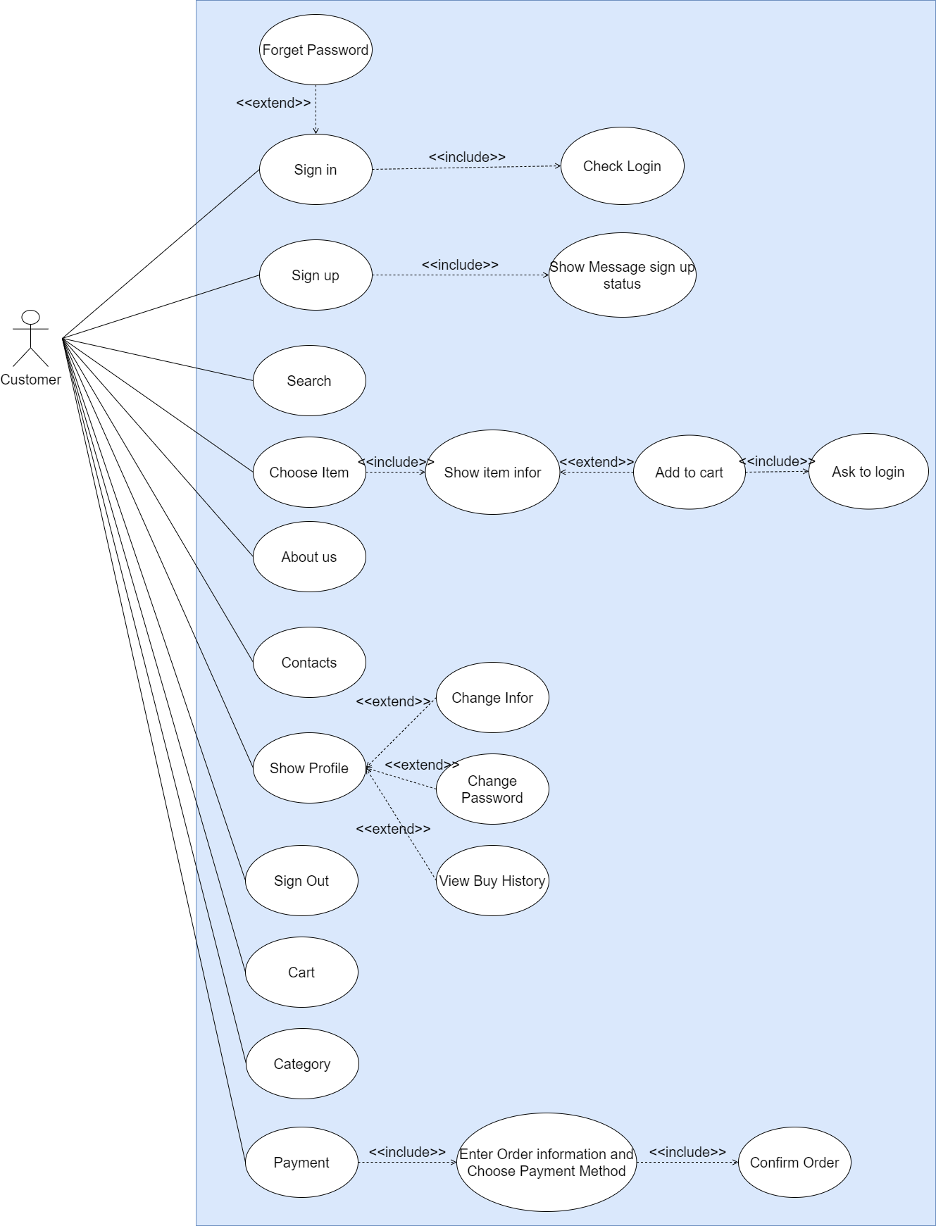
4. USECASE

Slide 7
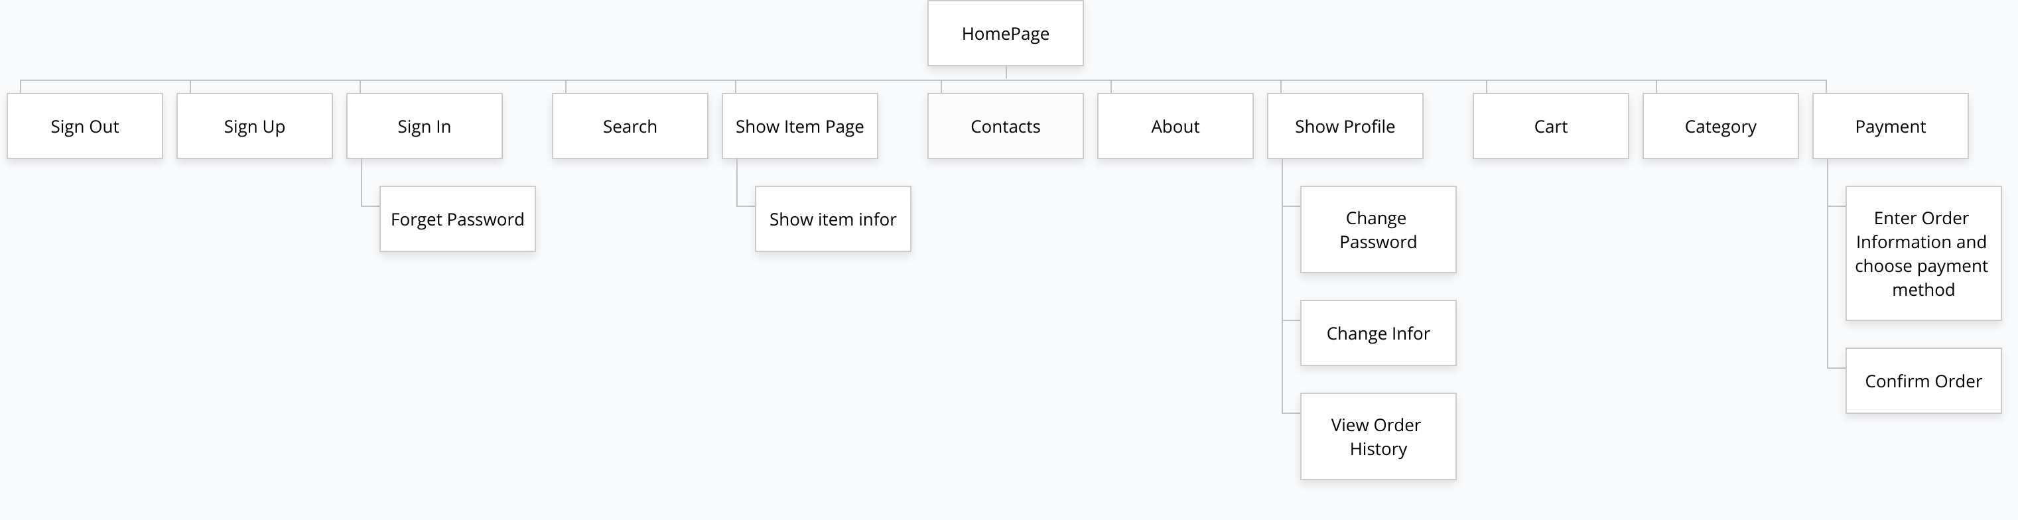
5. SITEMAP

Slide 8

6. DEMO

Slide 9

THANKS!
Any questions?

